Slide 1

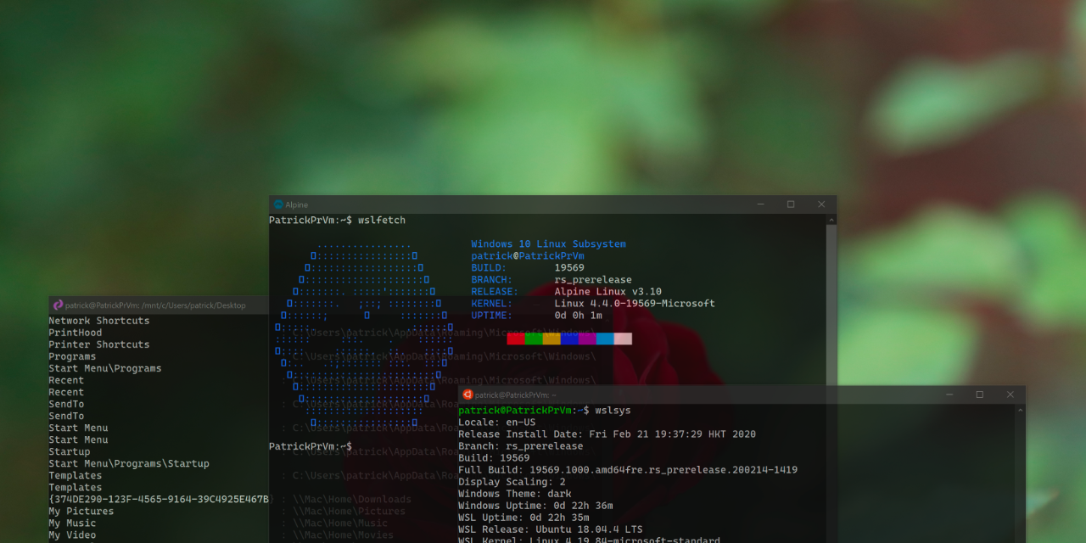

Scripting with WSL interoperability: Tips & Tricks
Jinming Wu, Patrick
Notes:
Hello Everyone, welcome to the session Scripting with WSL interoperability: Tips and Ticks.
I am Jinming Wu, but you can just call me Patrick.
In this session, I will cover some tips and tricks you might need when scripting with WSL interoperability. and I will use a brand-new feature that will be released in WSL Utilities to demonstrate how you can leverage WSL Interoperability to do awesome things.

Slide 2
Who Am I?
Just got a Bachelor degree in Computer Science in HKUST
Made a utility tool collection called WSL Utilities
Member of Whitewater Foundry; Focusing on developing Pengwin
Notes:
Before we begin, I would like to talk a bit about my self.
5 Sep 2016

Slide 3
WSL is awesome!
…and WSL Interoperability makes it 100x more awesome!
Notes:
Before WSL is awesome
I have been using WSL since its first release in insider fast ring, at the time it is called Bash on Ubuntu on Windows.
More I use WSL, the more I find WSL is awesome. (WSL is Awesome!) WSL helped me during my university life that it is longer required to run Dual Boot or run virtual machine.
WSL Interoperability makes it 100x more awesome. (WSL Inerop)
Doing things not possible using just virtual machine or dual boot
Make Linux- Windows Interaction better
Enables me to build WSL Utilities

Slide 4
Auto Mounting
Notes:
Auto mounting.
WSL automount some Windows partitions, but not other drive such as network locations.

Slide 5
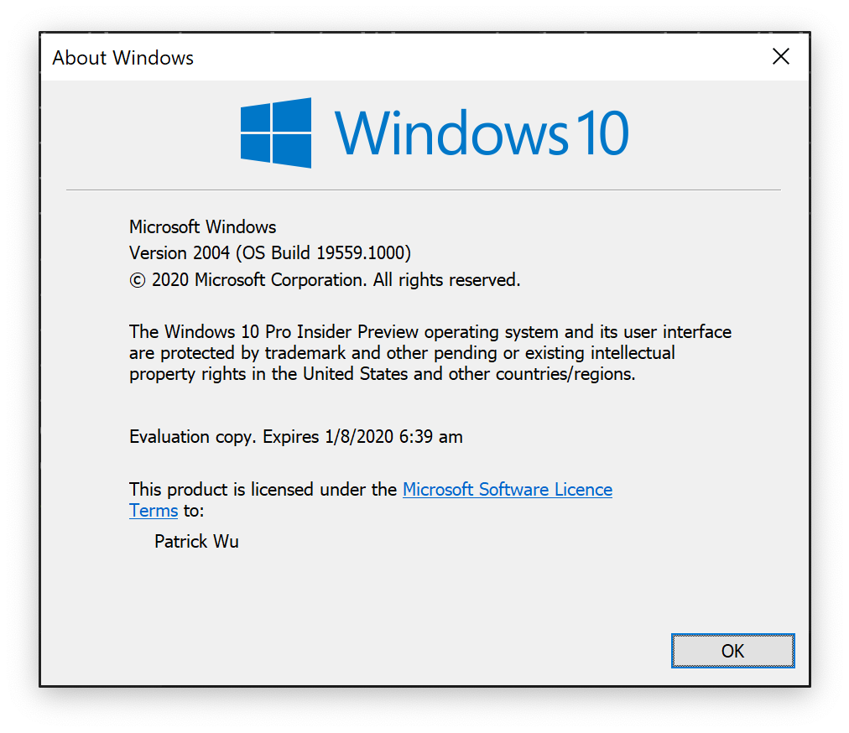
First of all…
Check your Windows version!

Slide 6
 | 1607 | 1703 | 1709 | 1803 1809 | 1903 1909 | 2004
lxrun.exe | ✓ | ✓ | ✓
bash.exe/wslconfig.exe | ✓ | ✓ | ✓^{*1} | ✓^{*1} | ✓^{*1} | ✓^{*1}
<distro>.exe |  |  | ✓ | ✓ | ✓ | ✓
wsl.exe |  |  | ✓ | ✓ | ✓^{*2} | ✓^{*2}
WSL Interoperability |  | ✓ | ✓ | ✓ | ✓ | ✓
DrvFS Mounting |  |  | ✓ | ✓ | ✓ | ✓
wsl.conf |  |  |  | ✓ | ✓^{*2} | ✓^{*2}
$WSL_DISTRO_NAME |  |  |  |  | ✓ | ✓
$WSLENV |  |  |  | ✓ | ✓ | ✓
\\wsl$\ |  |  |  |  | ✓ | ✓
WSL2 |  |  |  |  |  | ✓
/mnt/wsl/ |  |  |  |  |  | ✓
*1: Kept for backward compatibility
*2: feature of the function extended in these builds
Notes:
LTSC: 1809
Version for Education and Enterprise that still supported: 1709
Version for Other version that is still supported: 1809
Current Release: 1909

Slide 7
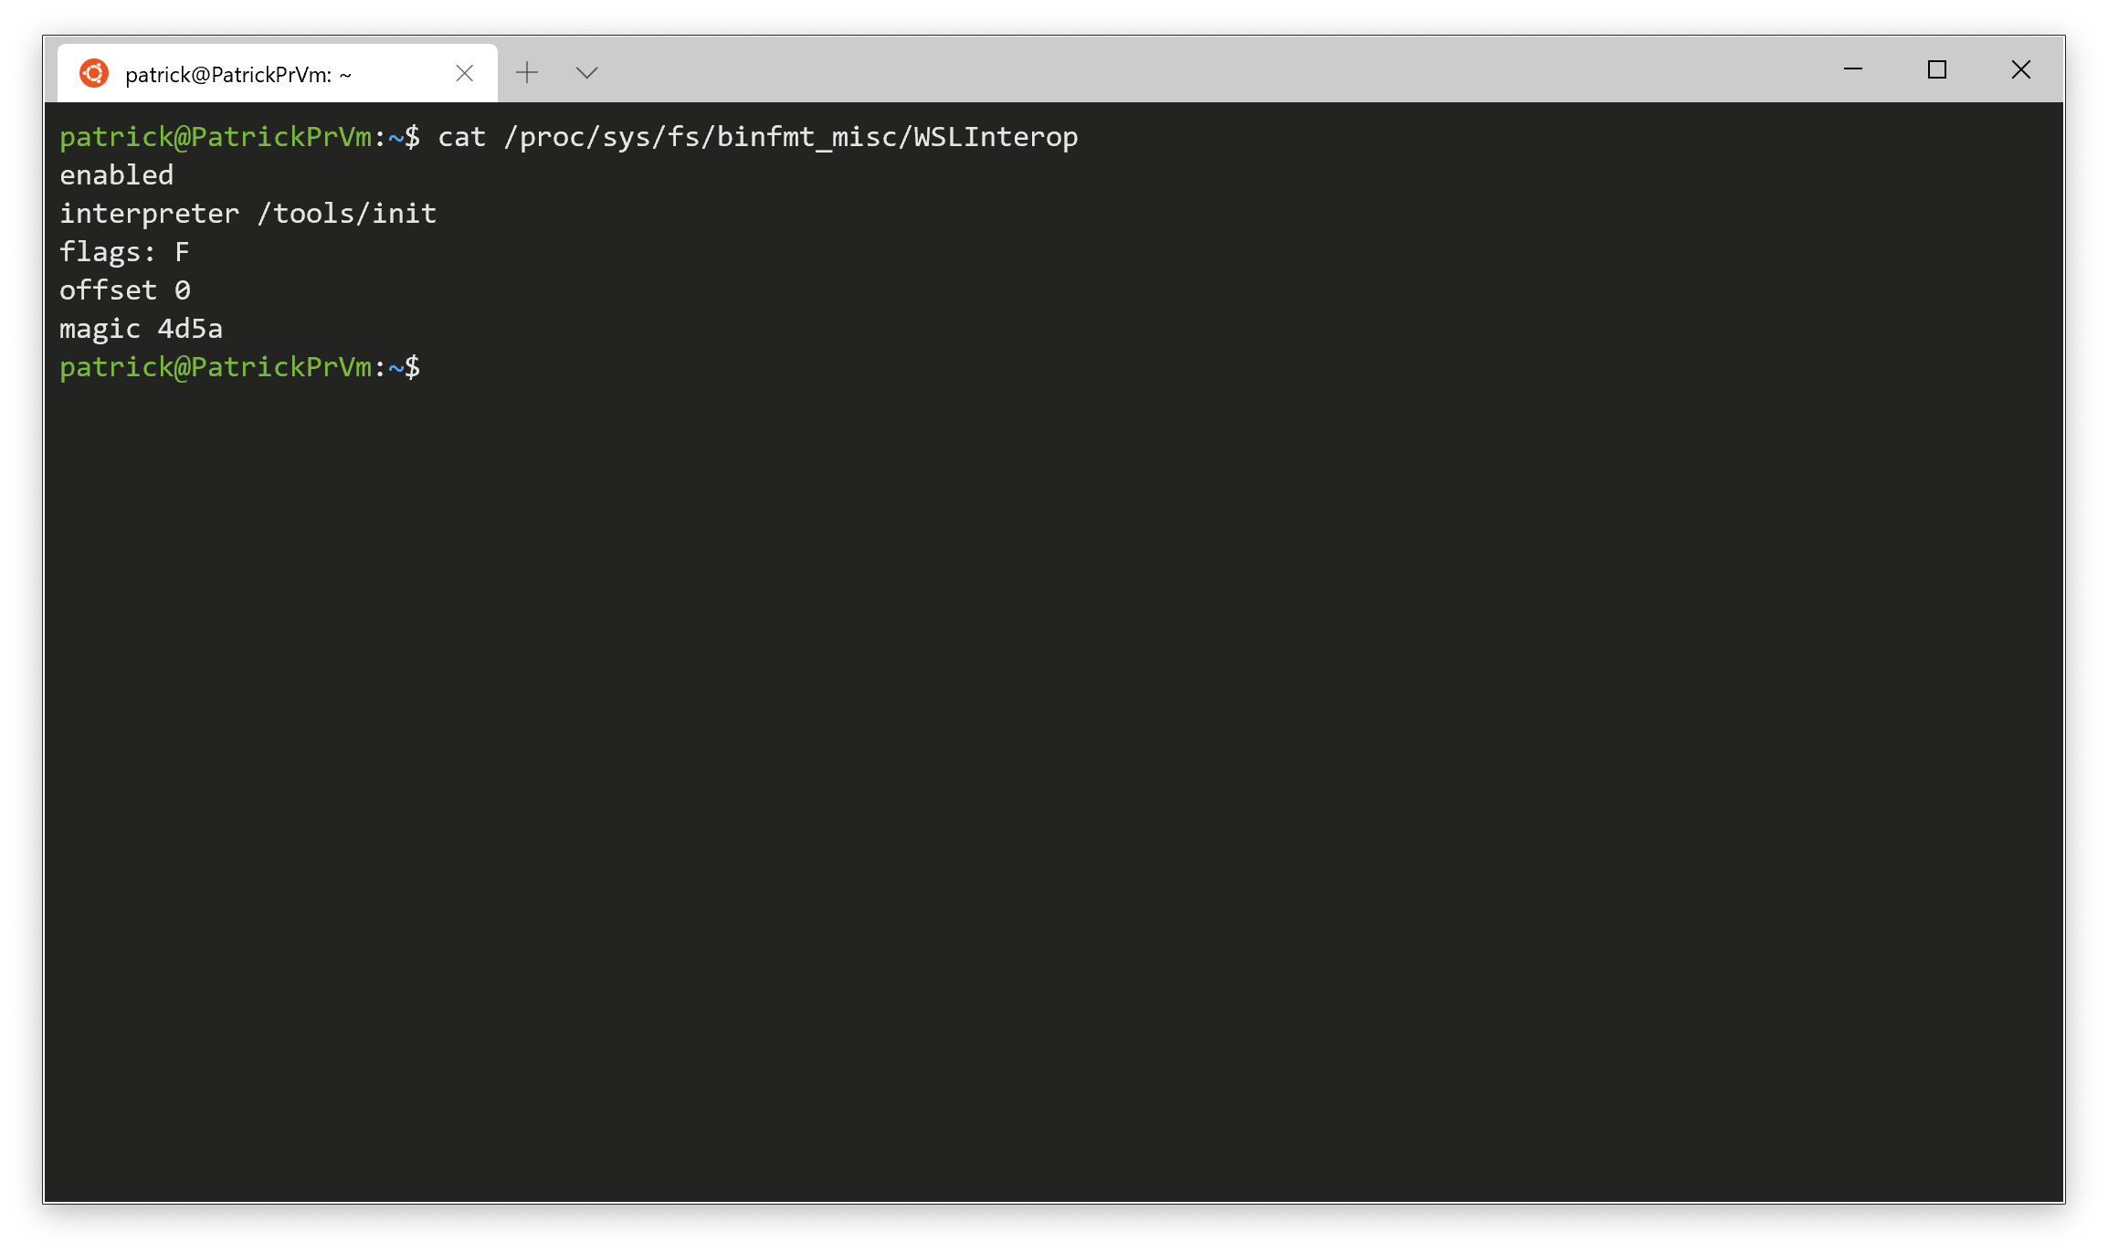
Check whether WSL Interoperability is enabled
/proc/sys/fs/binfmt_misc/WSLInterop
You can also use it for checking
whether it is WSL or normal Linux
Notes:
Process information pseudo file

Slide 8
/etc/wsl.conf
[automount]
enabled = true
root = /windir/
options = "metadata,umask=22,fmask=11"
mountFsTab = false
[network]
generateHosts = true
generateResolvConf = true
# 17713 or higher version
[interop]
enabled = True
appendWindowsPath = True
https://docs.microsoft.com/en-us/windows/wsl/wsl-config#set-wsl-launch-settings

Slide 9
Get the current Windows drive mounting point;
Get the current System drive.
Need to Get them
without running Windows Executables

Slide 10
individual tools (e.g., reg.exe)
cmd.exe
Execute Windows command on WSL Side
Running them with full path like:
/mnt/c/Windows/System32/cmd.exe
powershell.exe

Slide 11
individual tools (e.g., reg.exe)
Straightforward and fast
Possibility not supporting UNC path
…but no error will possibly be shown
\\network\location
\\wsl$\distro\path\to\linux\file
(/path/to/linux/file in WSL)
cmd.exe
powershell.exe

Slide 12
individual tools (e.g., reg.exe)
cmd.exe
With Command Prompt command support
Easier to use environment variables
Allows you to run scripts like .bat
cd /path/to/non/UNC/path/location &&
cmd.exe /C “[Command]”
‘\\just\a\UNC\path’
CMD.EXE was started with the above path as the current directory. UNC paths are not supported. Defaulting to Windows directory.
powershell.exe

Slide 13
individual tools (e.g., reg.exe)
cmd.exe
powershell.exe
Windows PowerShell not PowerShell Core
Allows you to execute PowerShell command and scripts

Slide 14
powershell.exe

Slide 15
powershell.exe
-Command ”<COMMAND>"

Slide 16
powershell.exe
-NoProfile –NonInteractive
-Command ”<COMMAND>"

Slide 17
powershell.exe
-NoProfile –NonInteractive
–ExecutionPolicy Bypass
-Command ”<COMMAND>"

Slide 18
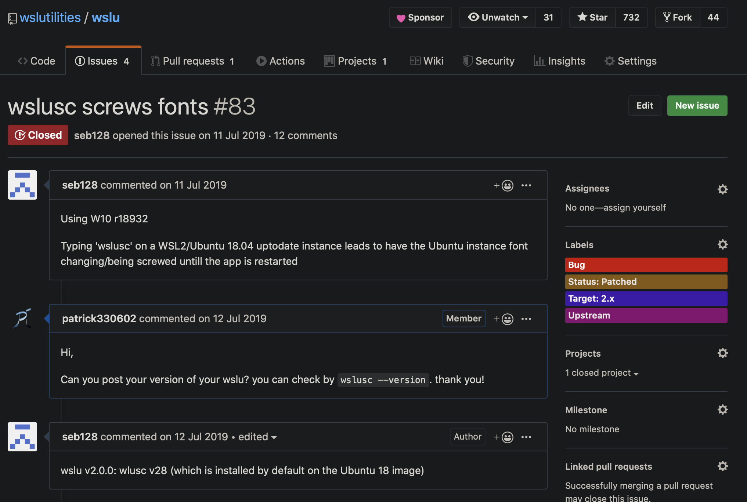
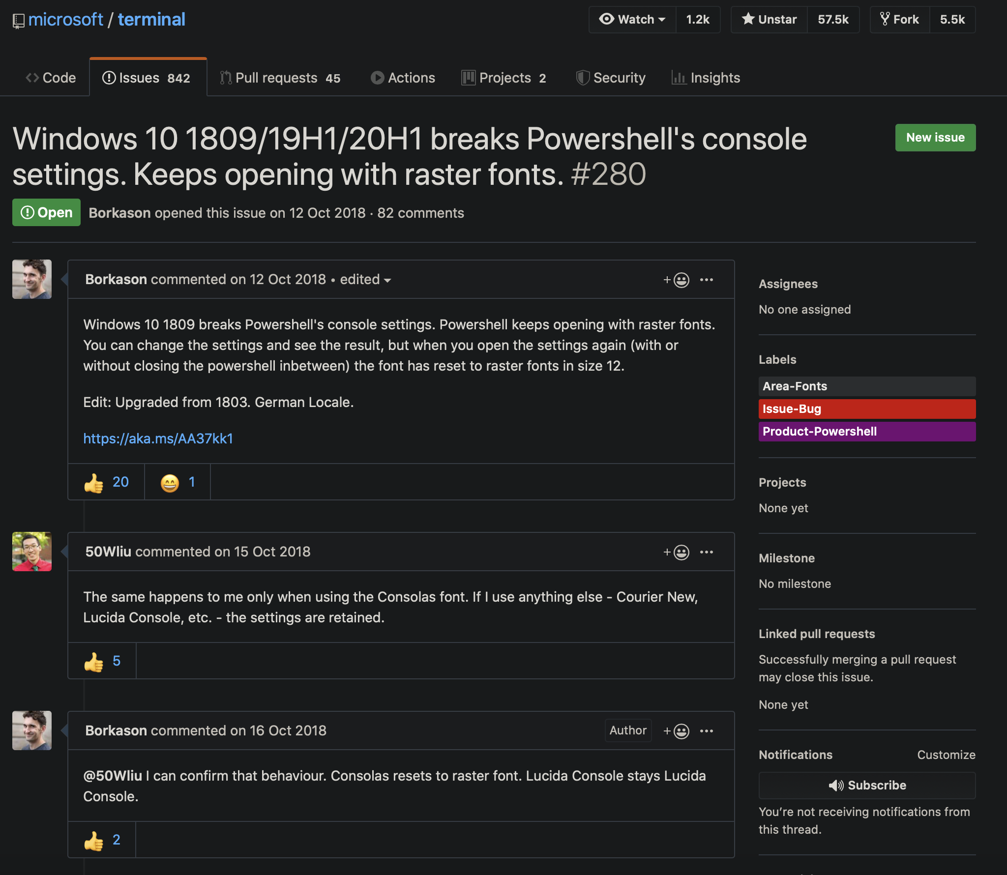
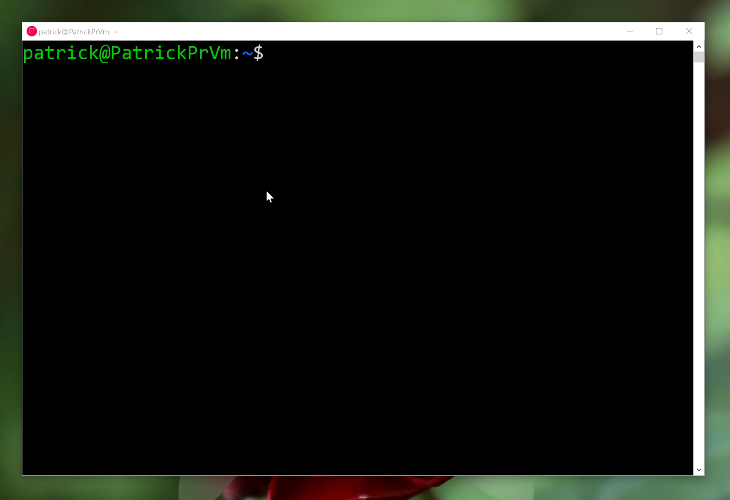
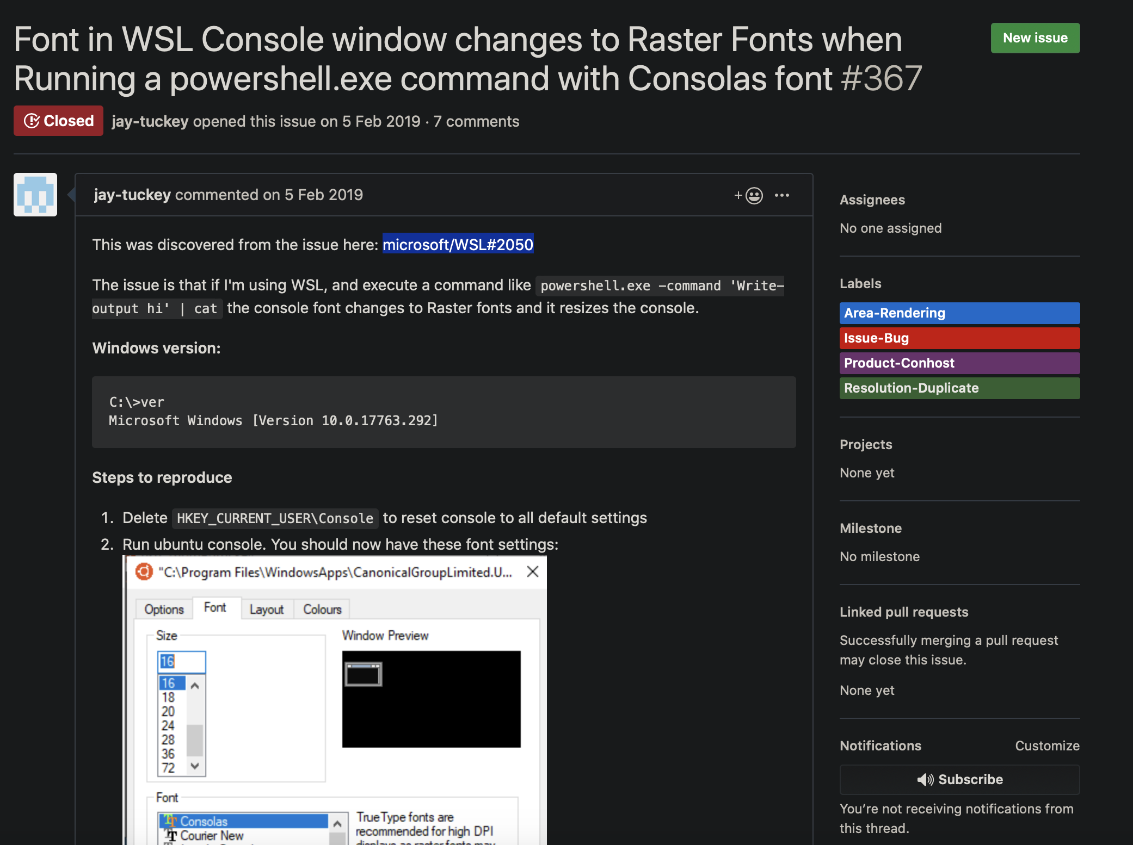
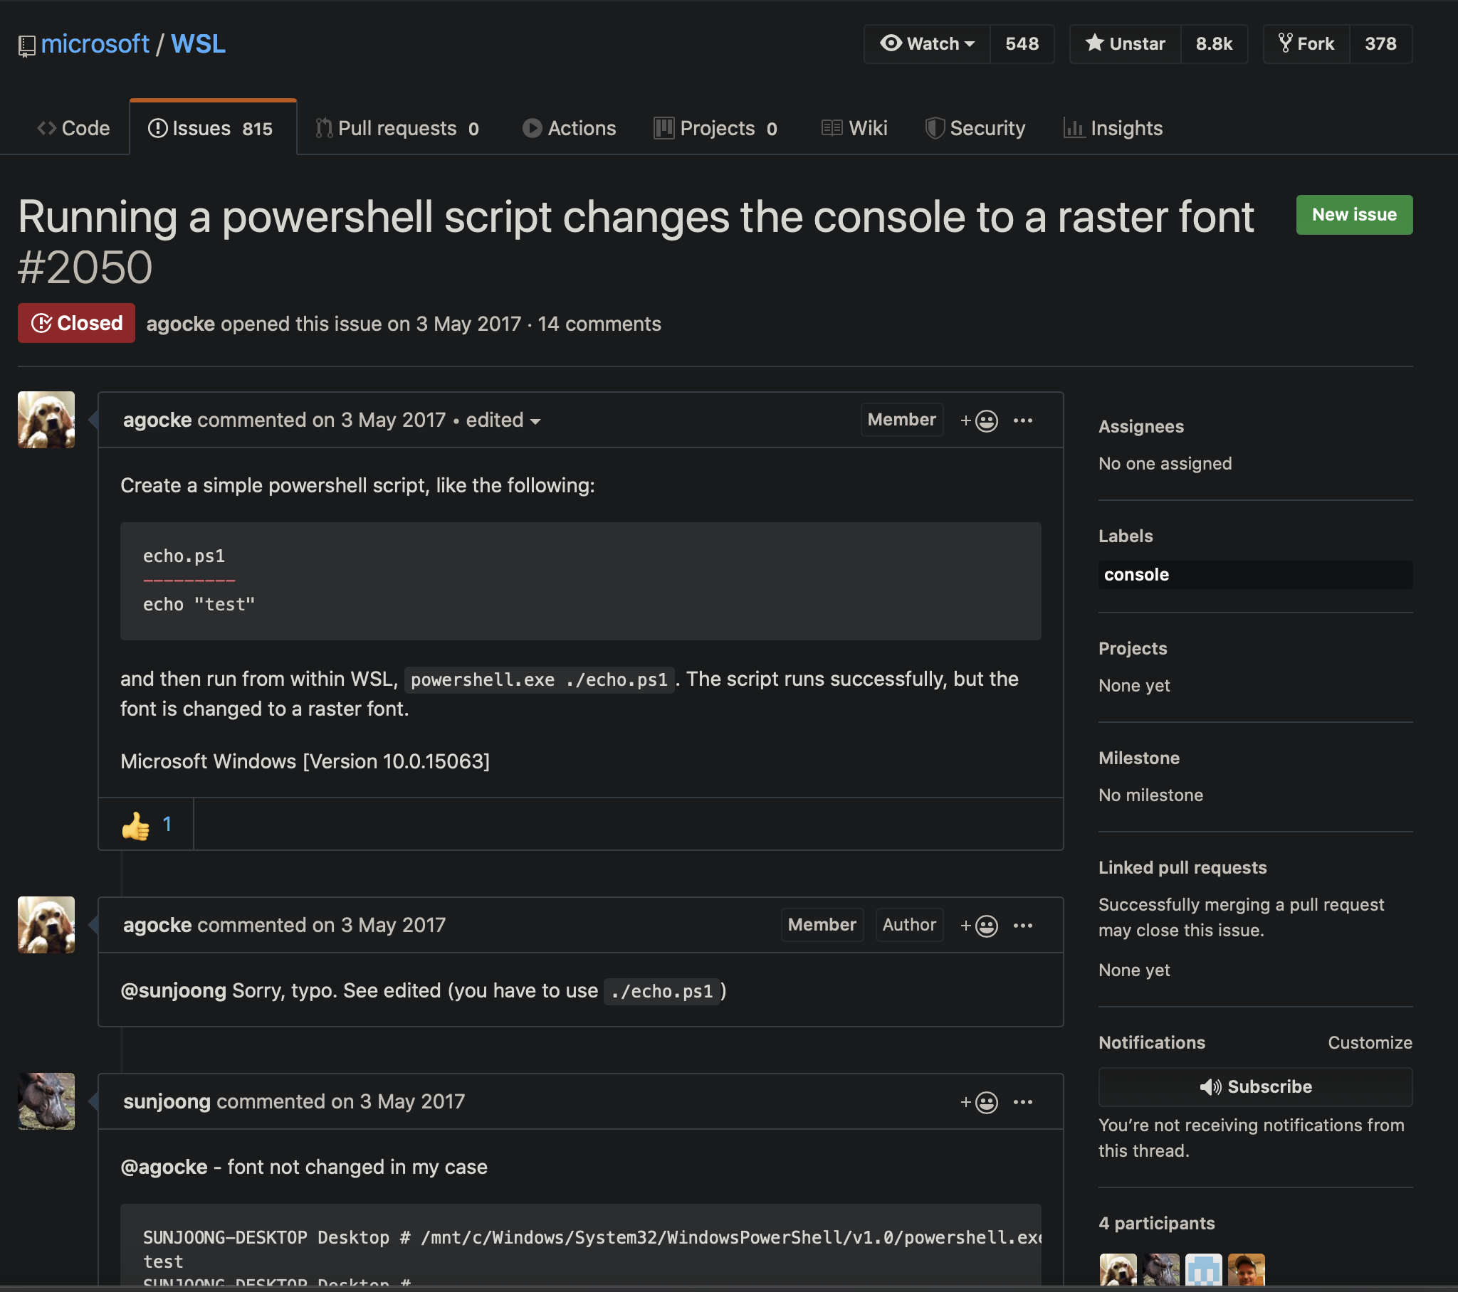
powershell.exe
RASTER FONT PROBLEM

Slide 19
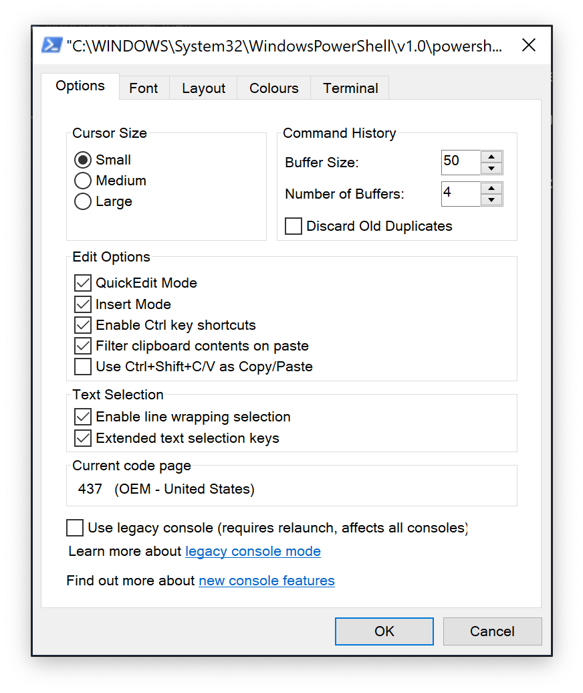
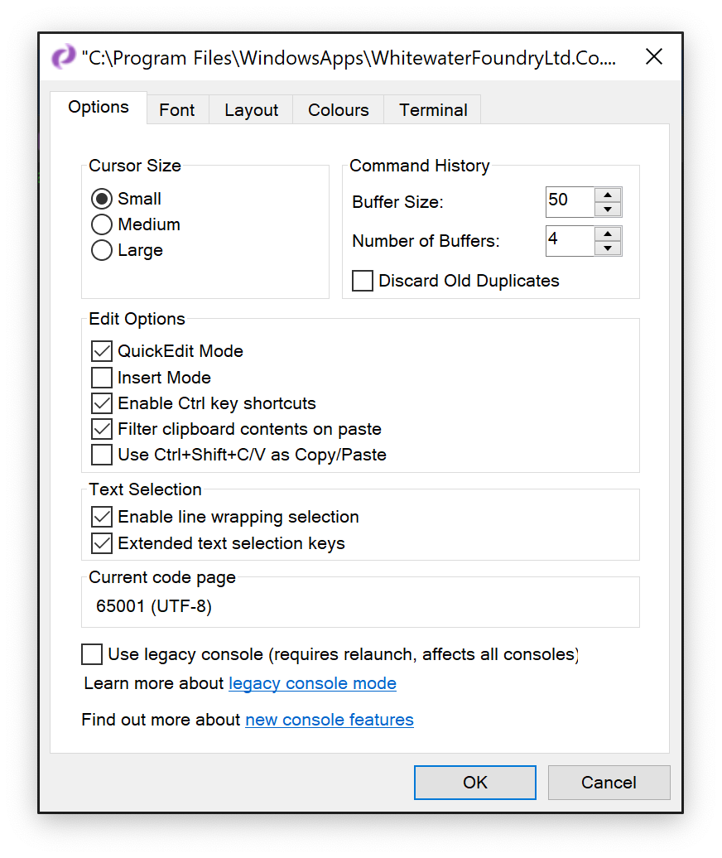
powershell.exe
RASTER FONT PROBLEM

Slide 20
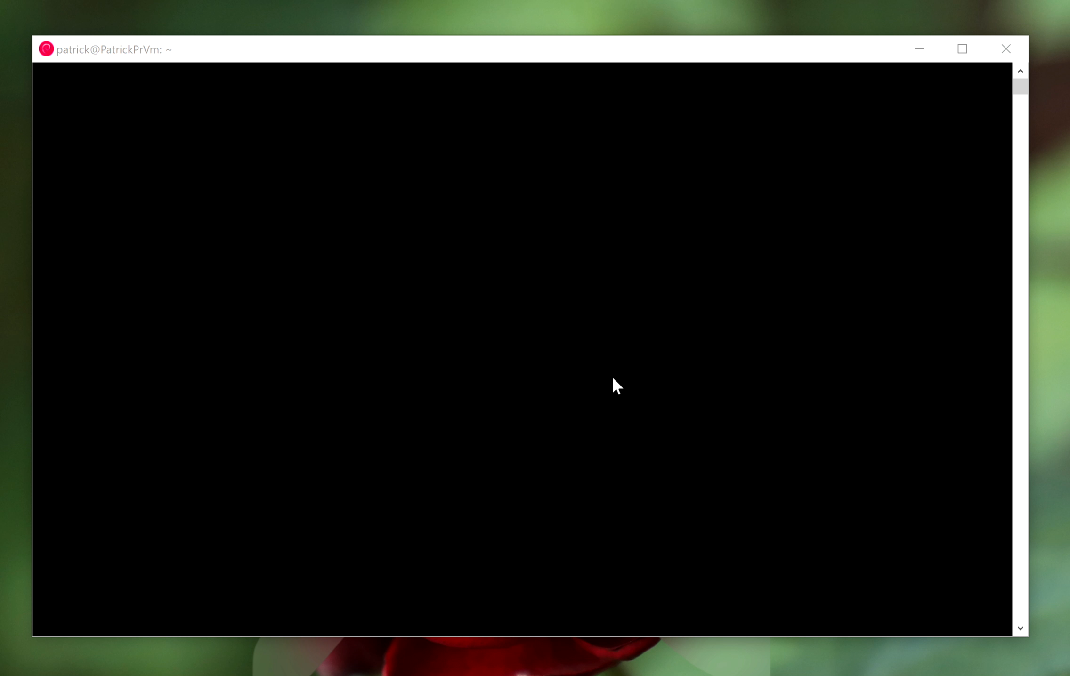
powershell.exe
RASTER FONT PROBLEM
HKLM\SYSTEM\CurrentControlSet\Control\Nls\CodePage\OEMCP
oemcp=$(cmd_to_get_oem_code_page)
chcp.com $oemcp
powershell.exe …
chcp.com 65001

Slide 21
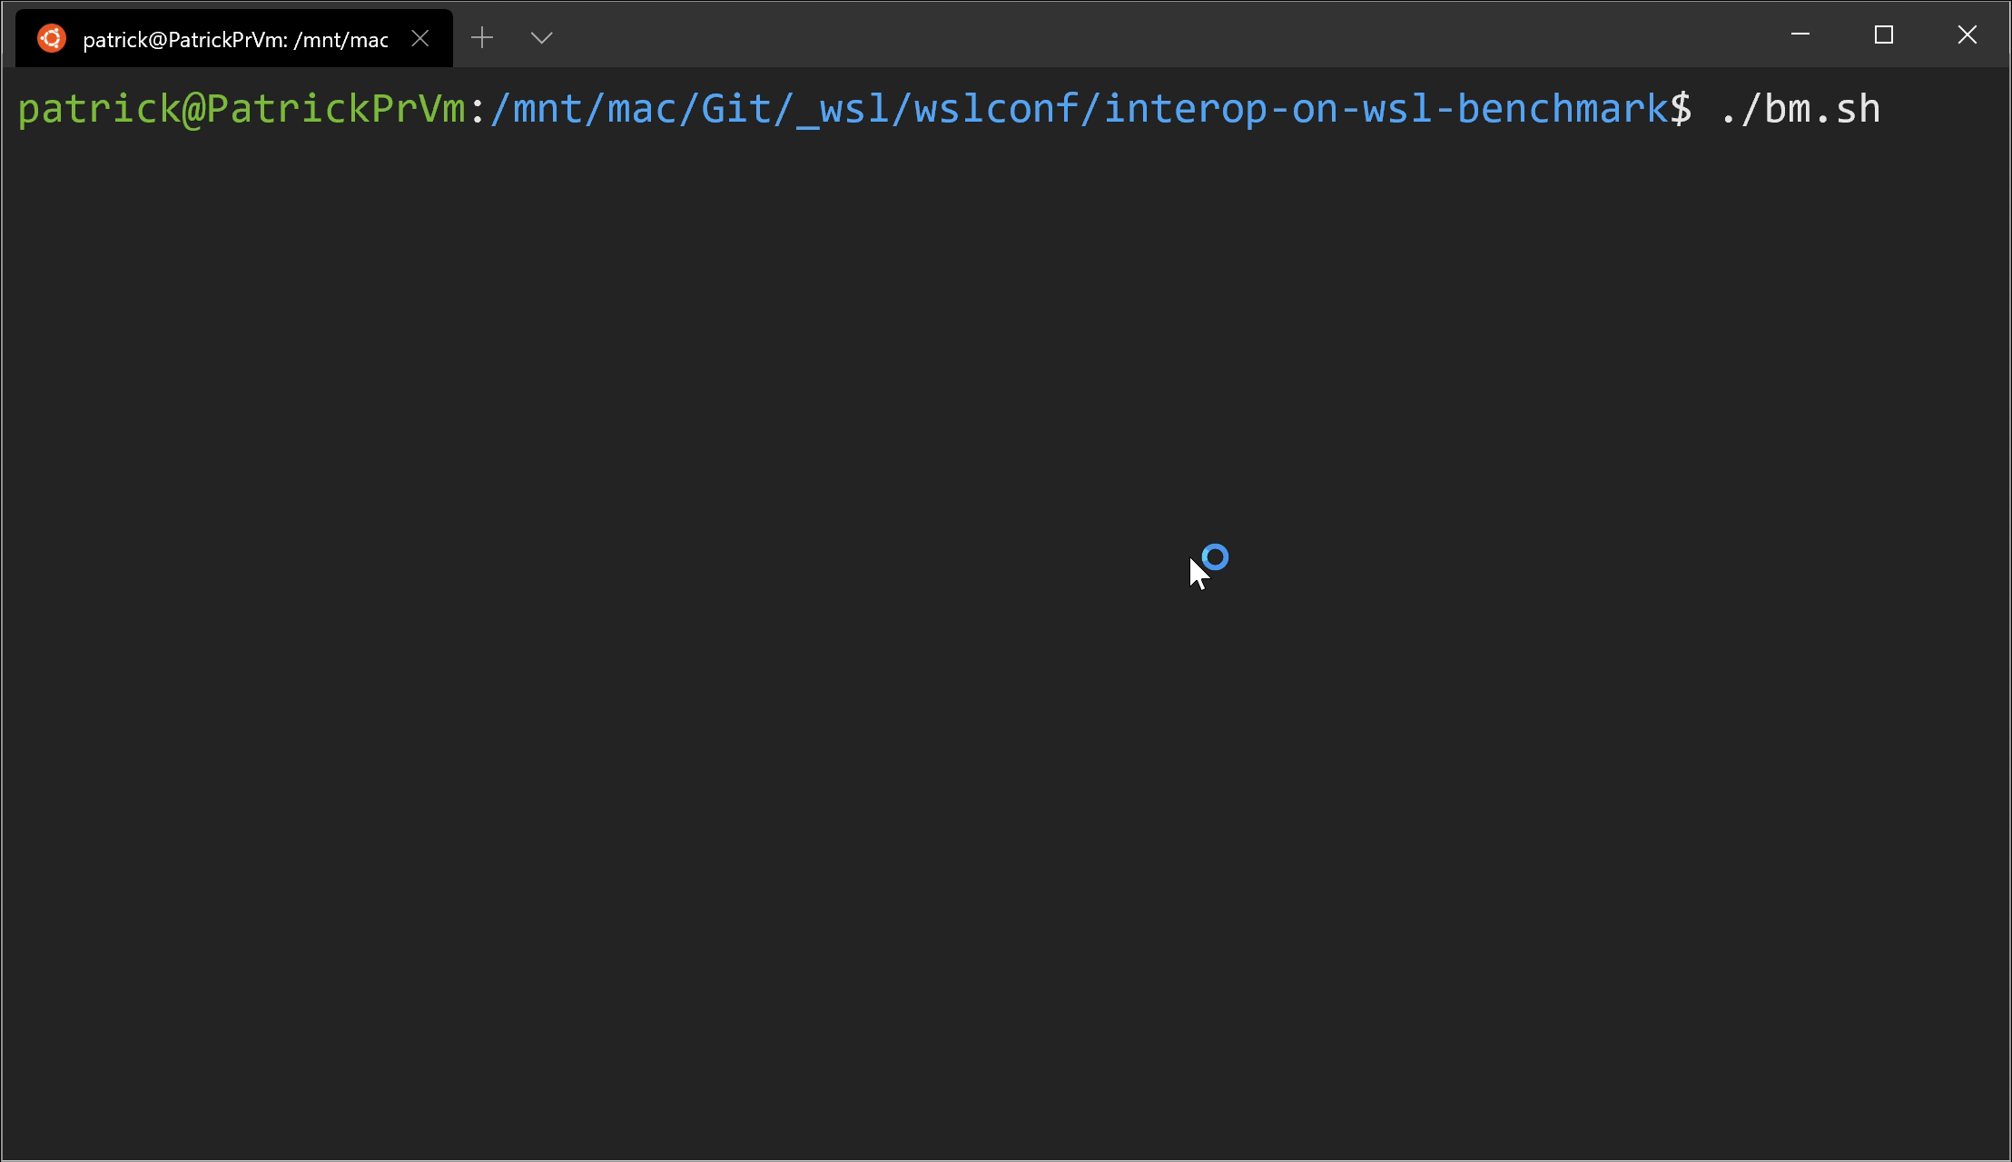
Execute Windows command on WSL Side
individual tools (e.g., reg.exe)
Uh… Benchmark?
cmd.exe
powershell.exe

Slide 22
Execute Windows command on WSL Side
individual tools (e.g., reg.exe)
cmd.exe
powershell.exe

Slide 23
bash.exe
wsl.exe
Execute WSL command on Windows Side
<distro>.exe

Slide 24
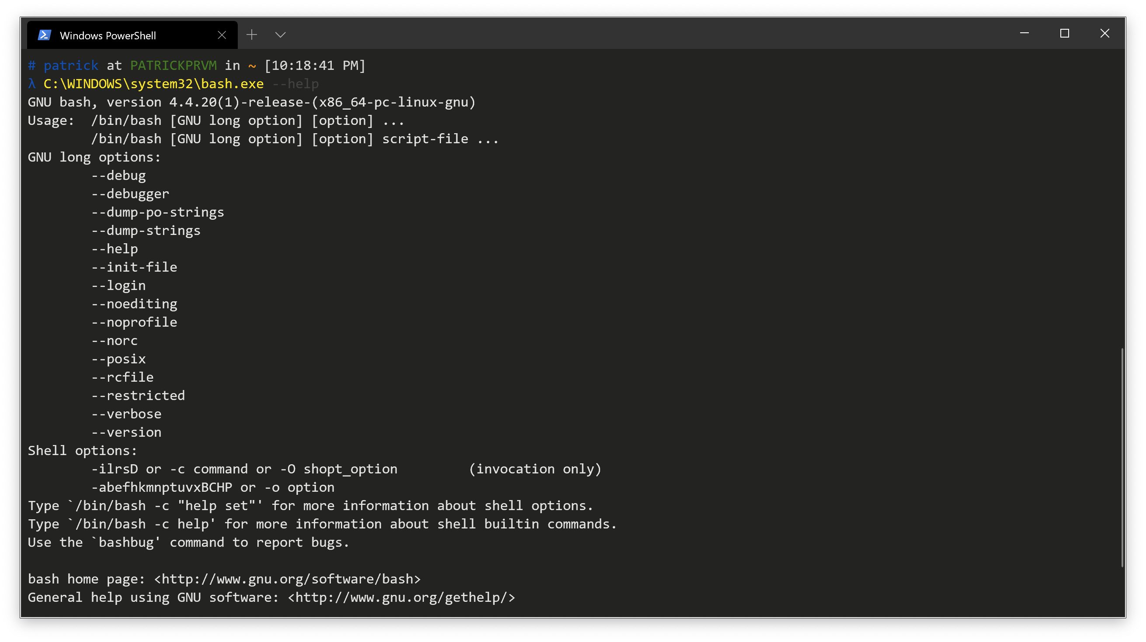
bash.exe
The remains of the legacy WSL
Bash on Ubuntu on Windows
bash.exe starts a bash login shell of your default WSL Linux distribution.
Uses bash command-line arguments.
bash.exe -c [Command]
wsl.exe
<distro>.exe

Slide 25
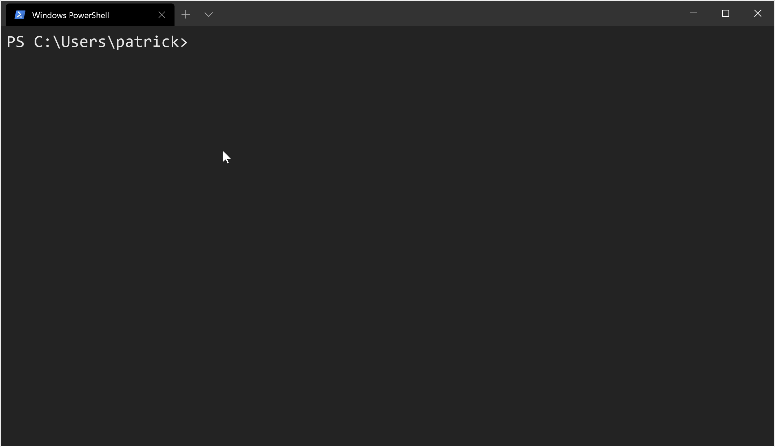
bash.exe
wsl.exe
Most advanced one
Merged features from wslconfig.exe
wsl.exe -d <distro> -u <user> -e [Command]
wsl.exe executes commands with the default login shell of your WSL distribution.
wsl.exe -e executes commands on your WSL distribution without any shell.
<distro>.exe
Notes:
Use the word Arguments!
First demo here(wsl.exe -e part); using Windows PowerShell (For Demo Use) to run ./wsl-e-param-compare.ps1

Slide 26
bash.exe
wsl.exe
<distro>.exe
<distro>.exe with no arguments launches the user's default shell in the user's home directory.
<distro>.exe can be different from
distribution registered name
Imported distribution
don’t have <distro>.exe
<distro>.exe run launches the user's default shell in the current working directory.
<distro>.exe run [Command] run the provided command line in the current working directory with user's default shell.
Notes:
Helps you that

Slide 27
WSL root access without sudo
bash.exe
<distro>.exe
wsl.exe
wsl.exe -d <Distro> -u root (-e) <Command>
Notes:
Real Demo here

Slide 28
Execute WSL command on Windows Side
bash.exe
wsl.exe
<distro>.exe

Slide 29
Let’s dive in the code!

Slide 30
WSL Interoperability
Registry Information for WSL
Execute Windows executables using Administrator on WSL
…

Slide 31

Resources
link to everything: https://patrickwu.space/wslconf
Twitter:
Personal: @patrick330602
WSL Utilities: @wslutilities
IRC:
Personal: callmepk @ freenode
WSL Utilities: #wslu @ freenode
References
microsoft/WSL on GitHub – https://github.com/Microsoft/WSL
WSL Documentation - https://docs.microsoft.com/en-us/windows/wsl/about
My posts about WSL - https://patrickwu.space/tags/WSL
Fonts Used
Px437 IBM VGA8 - https://int10h.org/oldschool-pc-fonts/ [CC BY-SA 4.0 license]
Cascadia Mono & Code - https://github.com/microsoft/cascadia-code [SIL Open Font License 1.1]

Slide 32
Thank you!
Now for Q & A

